Slide 1

Crowd Behavior Analysis for Enhanced Event Safety and Management
Under the guidance of Mrs.Evangeline D
Submitted by Jatin B– 1MS20IS054 Dept of Information Science & Engineering
Seminar - ISSE

Slide 2
Index
Motivation
Problem Statement
Objective
Literature Review

Slide 3
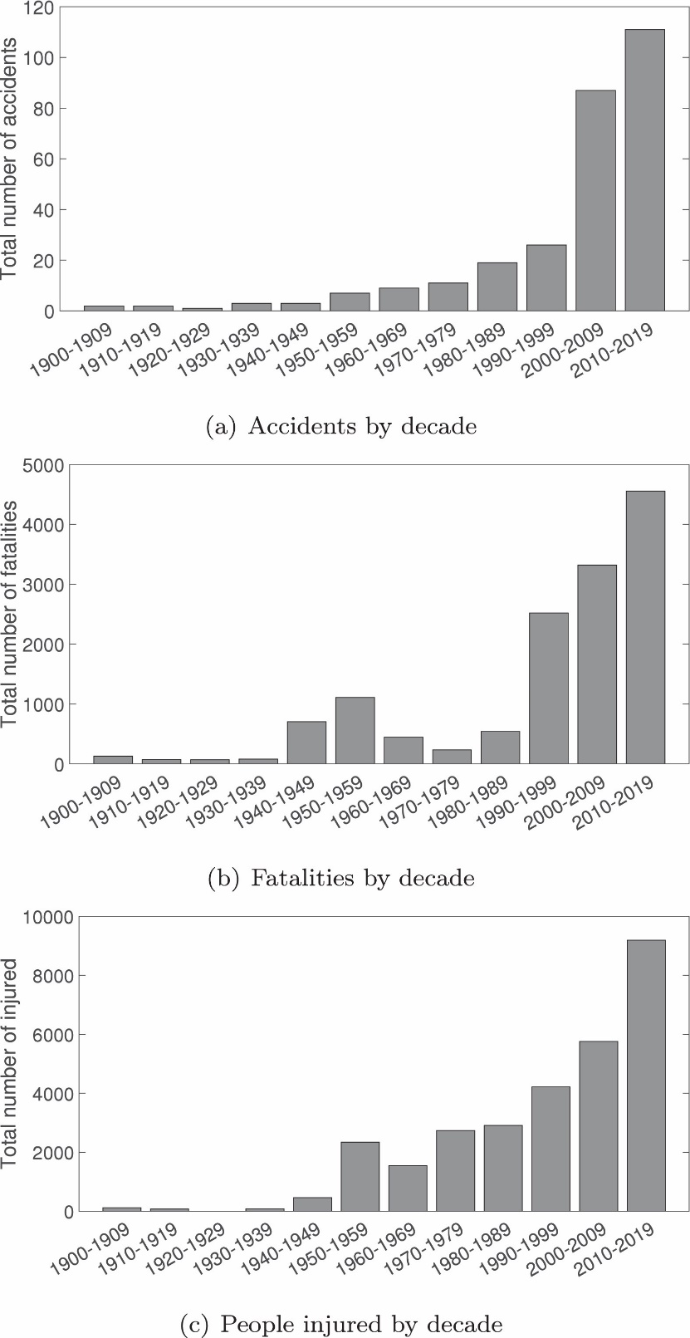
Motivation

Slide 4
Problem Statement
Large-scale events such as music festivals, sports games, and public gatherings often face challenges in crowd management and safety.
Crowd management and safety at large events are critical concerns, especially when unexpected incidents or overcrowding can lead to accidents.

Slide 5
Objective
Density of People
Fast Moving People in the Crowd
Detect People in a Different Direction

Slide 6
Literature review: Paper 1
Place crowd safety, crowd science:
Case studies and application
By
Keith Still and Marina Papalexi
Department of Business, Manchester Metropolitan University – All Saints Campus, Manchester, UK
Yiyi Fan
Department of Management, Lancaster University, Lancaster, UK
David Bamford
Department of Business, Manchester Metropolitan University – All Saints Campus, Manchester, UK
2020

Slide 7
Paper 1: Crowd Safety & Crowd Science Purpose
This paper aims to explore the development and application of place crowd safety management tools for areas of public assembly and major events, from a practitioner perspective.

Slide 8
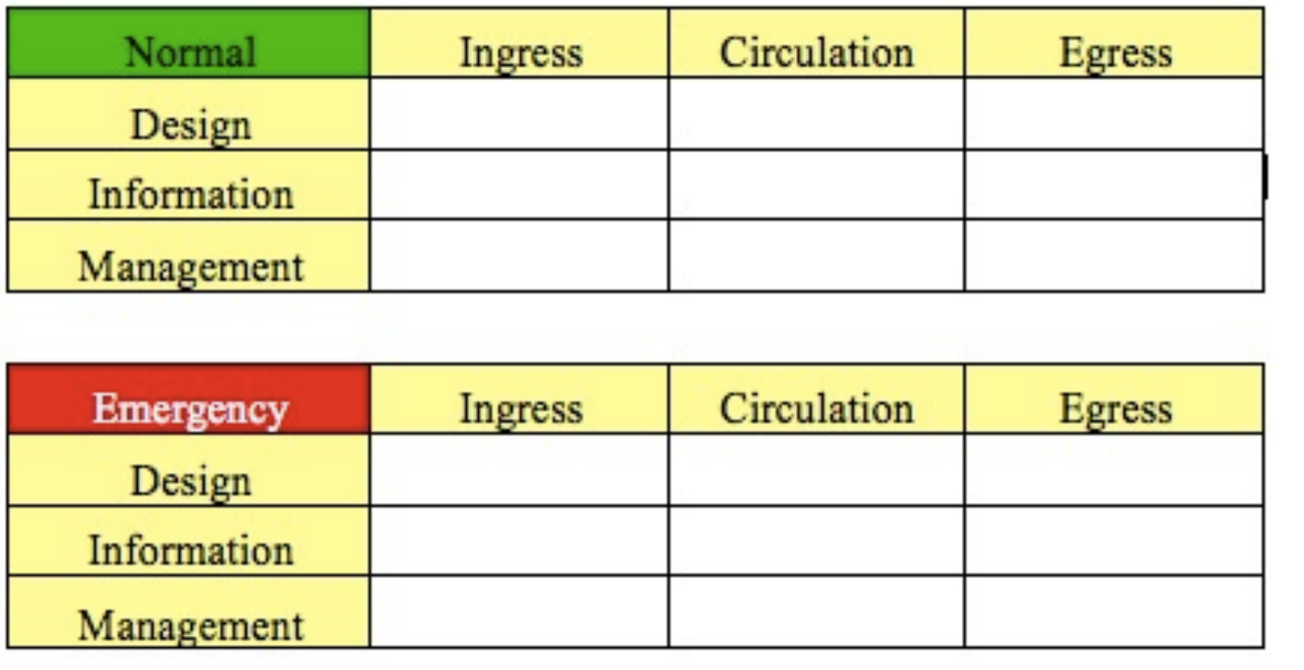
Paper 1: Crowd Safety & Crowd Science methodology
Design, Information, Management-Ingress, Circulation, Egress (DIM-ICE) (Still) is implemented to optimise crowd safety and potentially throughput.

Slide 9
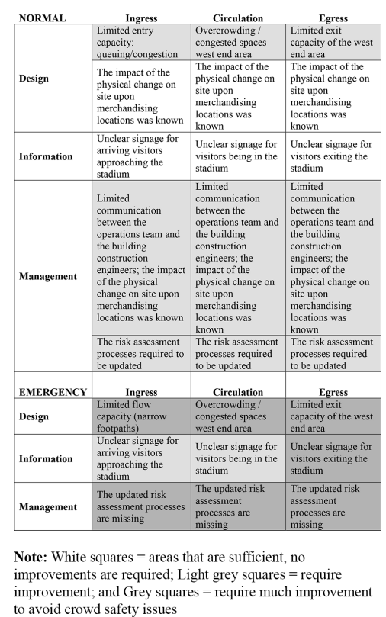
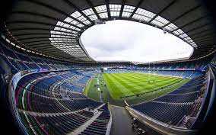
Paper 1: Crowd Safety & Crowd Science DIM-ICE: – the Murrayfield Stadium project

Slide 10
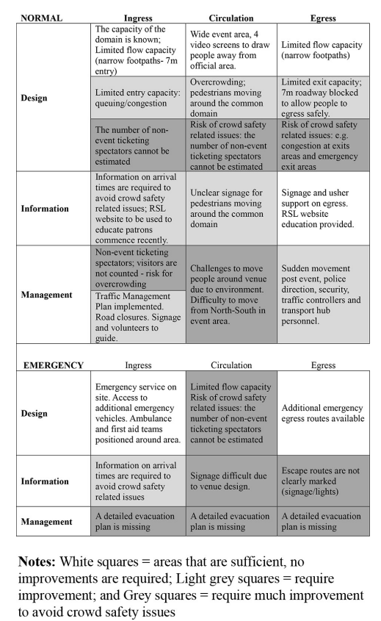
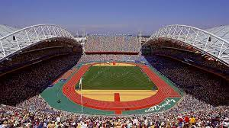
Paper 1: Crowd Safety & Crowd Science DIM-ICE: – The Sydney Olympics Project

Slide 11
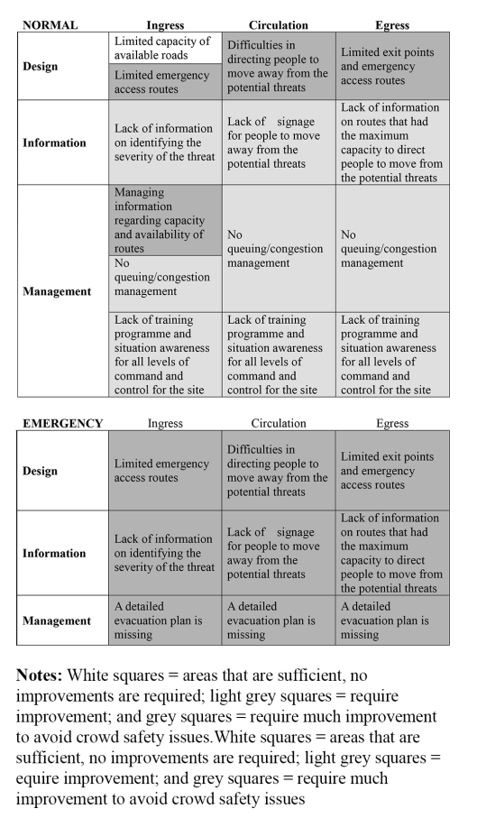

Paper 1: Crowd Safety & Crowd Science DIM-ICE: – the Canary Wharf Project

Slide 12
Paper 1: Crowd Safety & Crowd Science Inference
The need for Crowd Safety Analysis
How to analyse a particular site
Used to identify when to analyse more

Slide 13
Literature review: Paper 2
Effective Crowd Anomaly Detection Through
Spatio-temporal Texture Analysis
By
Yu Hao, Zhi-Jie Xu, Jiu-Lun Fan
School of Computer Science and Technology, Xi′an University of Posts and Telecommunications, Xi′an 710121, China
School of Computing and Engineering, University of Huddersfield, Huddersfield HD1 3DH, UK
Jing Wang
Faculty of Arts Computing Engineering and Sciences, Sheffield Hallam University, Sheffield S1 1WB, UK
2019

Slide 14
Paper 2: Effective Crowd Anomaly Detection Through Spatio-temporal Texture Analysis Purpose
Innovative Model: Model for analyzing spatial-temporal textures(STT) detect abnormal crowd behaviors.
Anomaly Detection: Using STT analysis, this model identifies irregularities in crowd movements and appearances,
Broad Applications: public safety, event management, and security, ensuring timely responses to crowd-related incidents

Slide 15
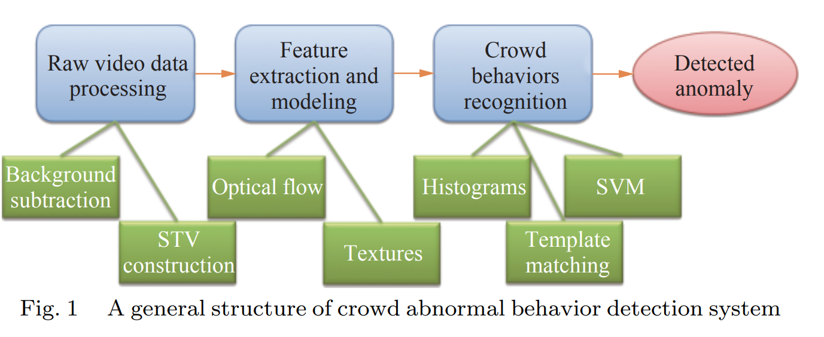
Paper 2: Effective Crowd Anomaly Detection Through Spatio-temporal Texture Analysis methodology
Notes:
Spatio-temporal data refers to data that varies both in space and time. It captures information about how certain attributes or phenomena change and evolve across different locations and over different time intervals. Spatio-temporal data is commonly encountered in various domains and can be represented in various forms, including images, videos, sensor readings, satellite imagery, and more.

Slide 16
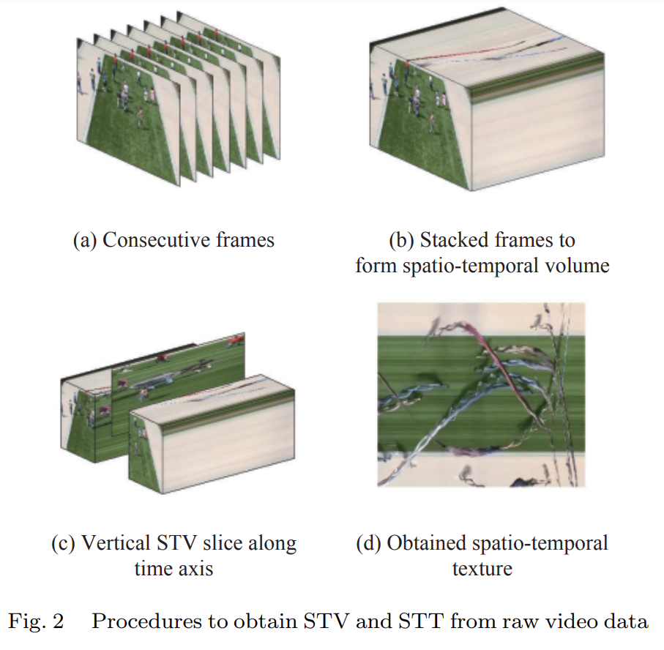
Paper 2: Effective Crowd Anomaly Detection Through Spatio-temporal Texture Analysis Spatio-temporal texture analysis
The study of how textures change over different spatial locations and across different time frames. This analysis can provide valuable insights into the underlying patterns and dynamics within spatio-temporal data.
Notes:
Spatio-temporal data refers to data that varies both in space and time. It captures information about how certain attributes or phenomena change and evolve across different locations and over different time intervals. Spatio-temporal data is commonly encountered in various domains and can be represented in various forms, including images, videos, sensor readings, satellite imagery, and more.

Slide 17
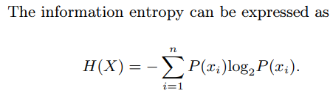

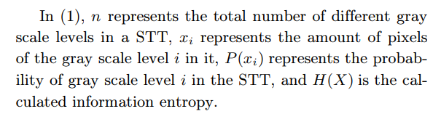
Paper 2: Effective Crowd Anomaly Detection Through Spatio-temporal Texture Analysis Spatio-temporal volume slicing
Approach 1: Information entropy
Notes:
Spatio-temporal data refers to data that varies both in space and time. It captures information about how certain attributes or phenomena change and evolve across different locations and over different time intervals. Spatio-temporal data is commonly encountered in various domains and can be represented in various forms, including images, videos, sensor readings, satellite imagery, and more.

Slide 18
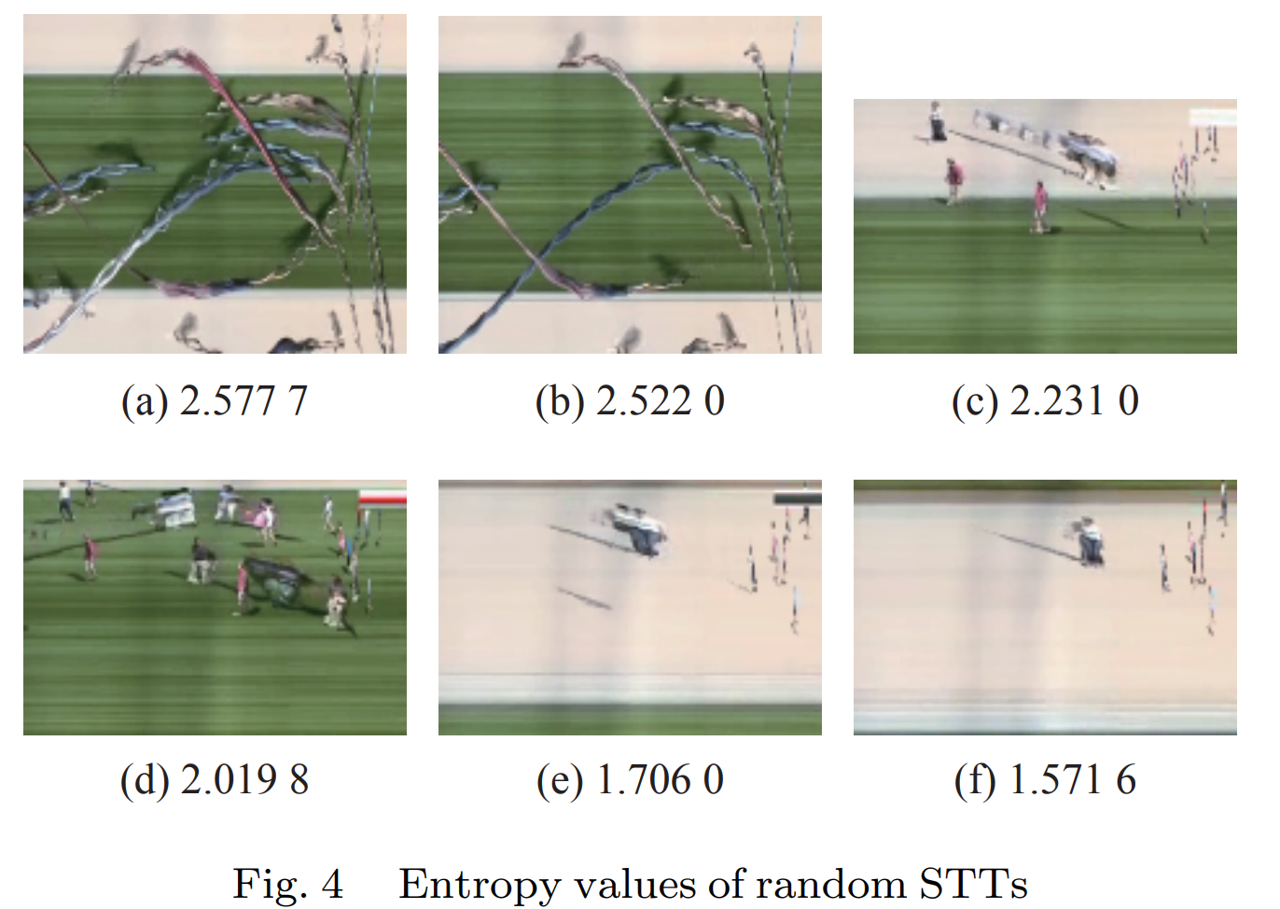

Paper 2: Effective Crowd Anomaly Detection Through Spatio-temporal Texture Analysis Spatio-temporal volume slicing
Approach 1: Information entropy
Notes:
Spatio-temporal data refers to data that varies both in space and time. It captures information about how certain attributes or phenomena change and evolve across different locations and over different time intervals. Spatio-temporal data is commonly encountered in various domains and can be represented in various forms, including images, videos, sensor readings, satellite imagery, and more.

Slide 19
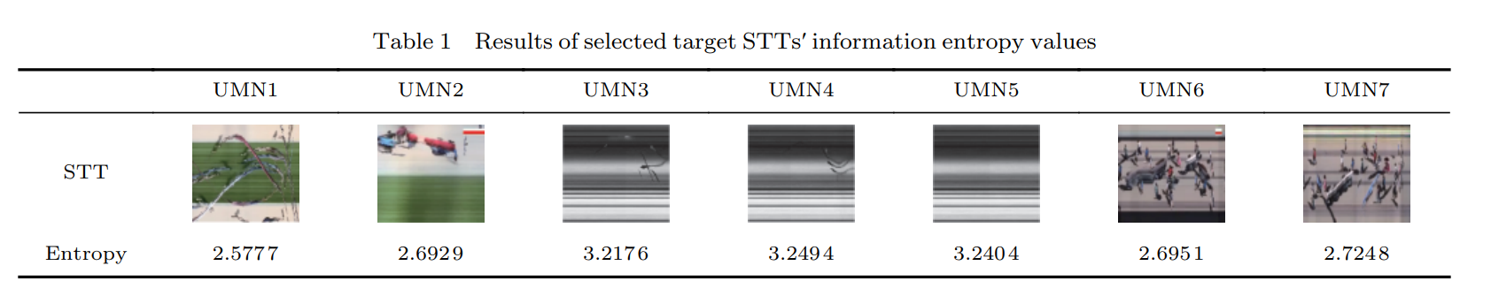
Paper 2: Effective Crowd Anomaly Detection Through Spatio-temporal Texture Analysis Spatio-temporal volume slicing
Approach 1: Information entropy
Notes:
Spatio-temporal data refers to data that varies both in space and time. It captures information about how certain attributes or phenomena change and evolve across different locations and over different time intervals. Spatio-temporal data is commonly encountered in various domains and can be represented in various forms, including images, videos, sensor readings, satellite imagery, and more.

Slide 20
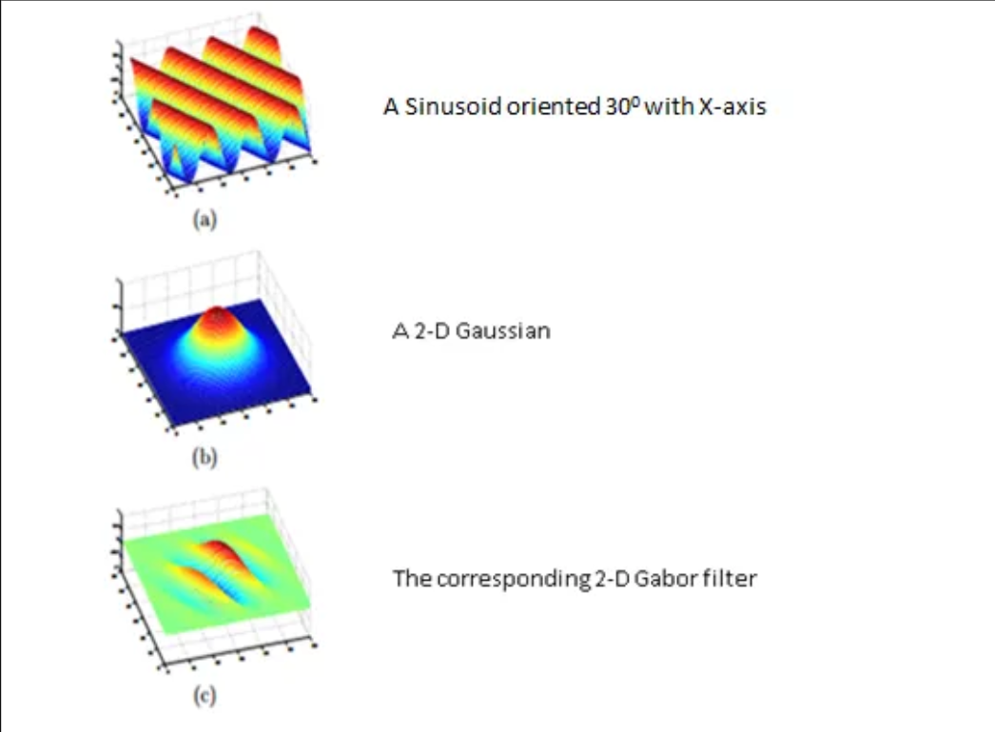
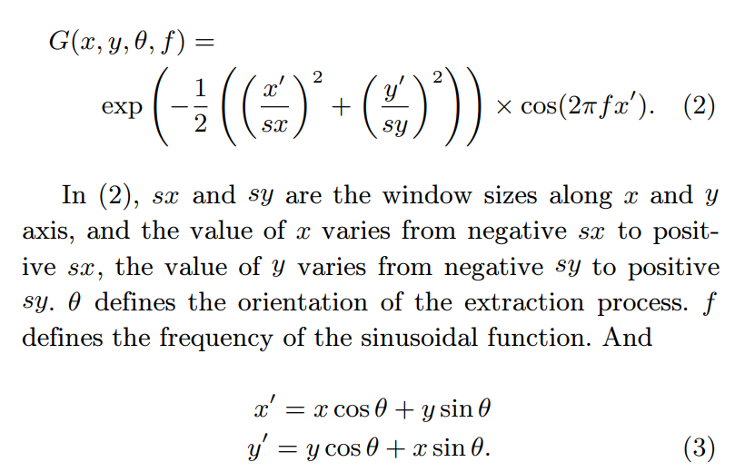
Paper 2: Effective Crowd Anomaly Detection Through Spatio-temporal Texture Analysis Spatio-temporal volume slicing
Approach 2: Optimization through Gabor Filtering
Notes:
Spatio-temporal data refers to data that varies both in space and time. It captures information about how certain attributes or phenomena change and evolve across different locations and over different time intervals. Spatio-temporal data is commonly encountered in various domains and can be represented in various forms, including images, videos, sensor readings, satellite imagery, and more.

Slide 21
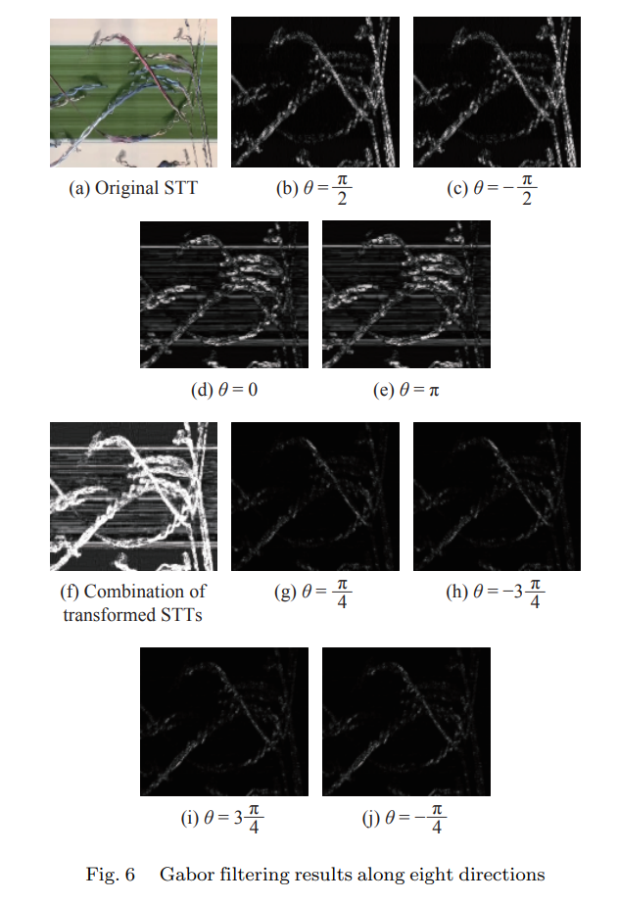
Paper 2: Effective Crowd Anomaly Detection Through Spatio-temporal Texture Analysis Spatio-temporal volume slicing
Approach 2: Optimization through Gabor filtering
Notes:
Spatio-temporal data refers to data that varies both in space and time. It captures information about how certain attributes or phenomena change and evolve across different locations and over different time intervals. Spatio-temporal data is commonly encountered in various domains and can be represented in various forms, including images, videos, sensor readings, satellite imagery, and more.

Slide 22
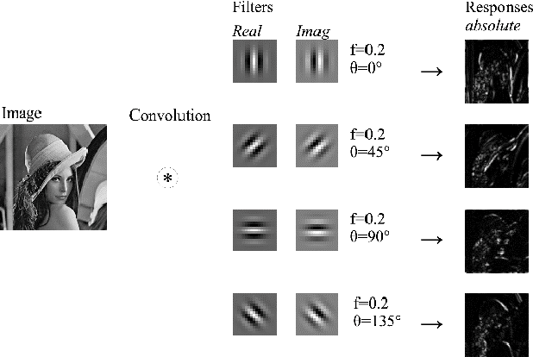
Paper 2: Effective Crowd Anomaly Detection Through Spatio-temporal Texture Analysis Spatio-temporal volume slicing
Approach 2: Optimization through Gabor Filtering
Notes:
Spatio-temporal data refers to data that varies both in space and time. It captures information about how certain attributes or phenomena change and evolve across different locations and over different time intervals. Spatio-temporal data is commonly encountered in various domains and can be represented in various forms, including images, videos, sensor readings, satellite imagery, and more.

Slide 23
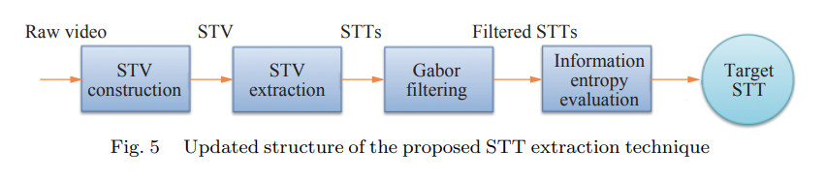
Paper 2: Effective Crowd Anomaly Detection Through Spatio-temporal Texture Analysis Spatio-temporal volume slicing
Approach 2: Optimization through Gabor filtering
Notes:
Spatio-temporal data refers to data that varies both in space and time. It captures information about how certain attributes or phenomena change and evolve across different locations and over different time intervals. Spatio-temporal data is commonly encountered in various domains and can be represented in various forms, including images, videos, sensor readings, satellite imagery, and more.

Slide 24
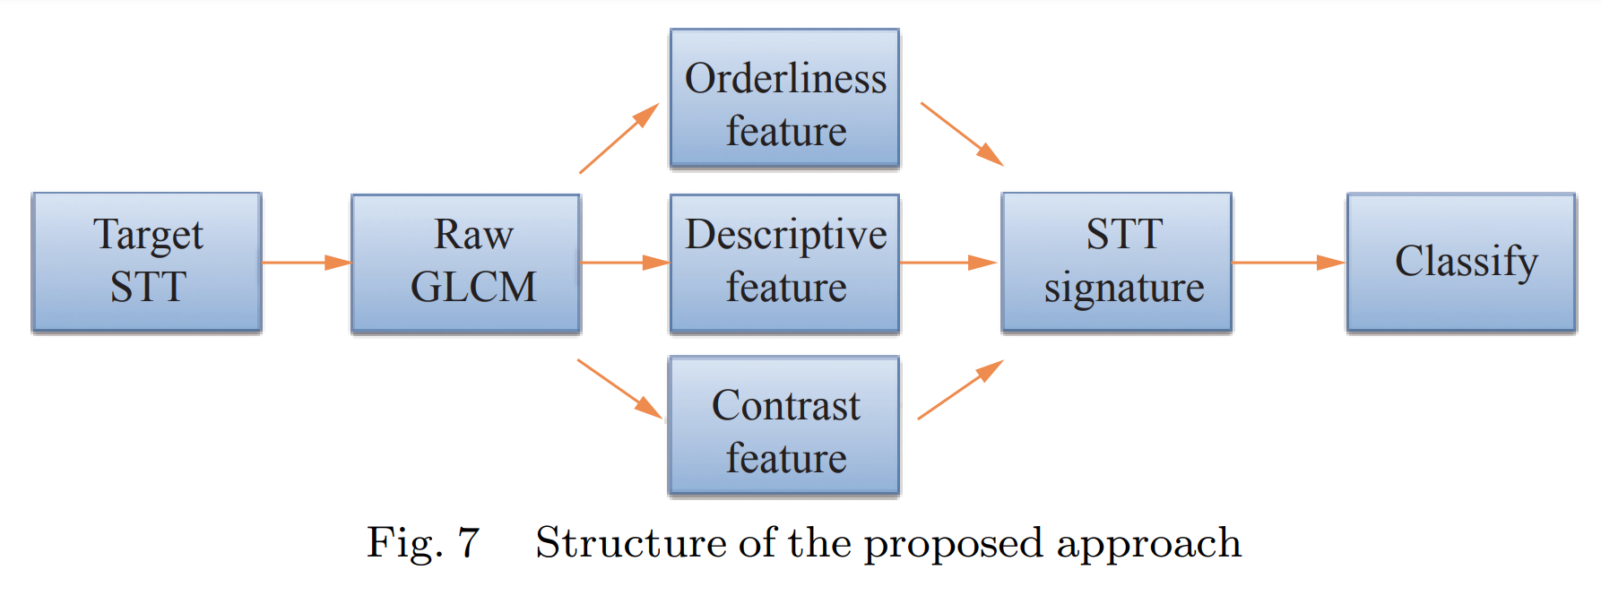
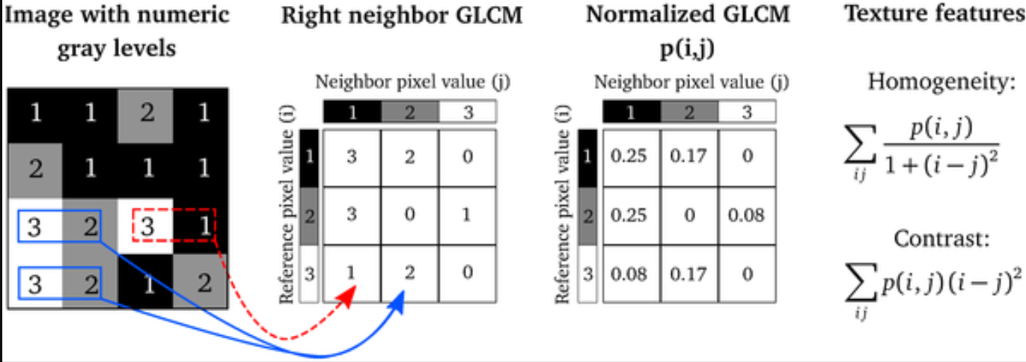
Paper 2: Effective Crowd Anomaly Detection Through Spatio-temporal Texture Analysis methodology: Gray Level Co-occurrence Matrix (GLCM)
Notes:
Spatio-temporal data refers to data that varies both in space and time. It captures information about how certain attributes or phenomena change and evolve across different locations and over different time intervals. Spatio-temporal data is commonly encountered in various domains and can be represented in various forms, including images, videos, sensor readings, satellite imagery, and more.

Slide 25
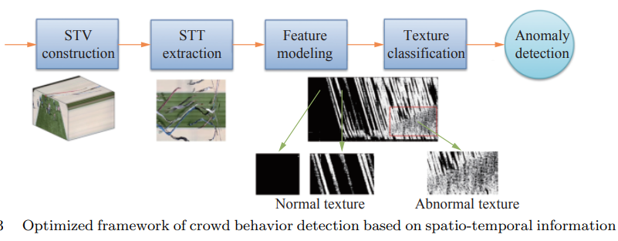
Paper 2: Effective Crowd Anomaly Detection Through Spatio-temporal Texture Analysis methodology
v
Notes:
Spatio-temporal data refers to data that varies both in space and time. It captures information about how certain attributes or phenomena change and evolve across different locations and over different time intervals. Spatio-temporal data is commonly encountered in various domains and can be represented in various forms, including images, videos, sensor readings, satellite imagery, and more.

Slide 26
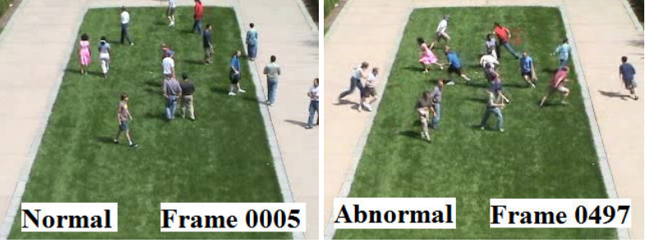
Paper 2: Effective Crowd Anomaly Detection Through Spatio-temporal Texture Analysis Dataset description
The UMN(University of Minnesota) dataset:
The UMN dataset consist of 11 videos, and each video contains normal and abnormal crowd behaviors. There are three different scenes in this dataset (two outdoor scenes and one indoor scene).
link: Monitoring Human Activity
Notes:
Spatio-temporal data refers to data that varies both in space and time. It captures information about how certain attributes or phenomena change and evolve across different locations and over different time intervals. Spatio-temporal data is commonly encountered in various domains and can be represented in various forms, including images, videos, sensor readings, satellite imagery, and more.

Slide 27
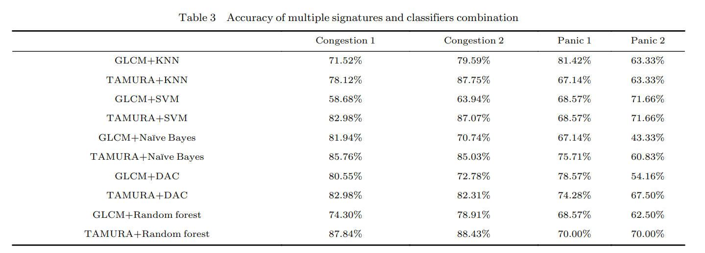
Paper 2: Effective Crowd Anomaly Detection Through Spatio-temporal Texture Analysis Results
Notes:
Spatio-temporal data refers to data that varies both in space and time. It captures information about how certain attributes or phenomena change and evolve across different locations and over different time intervals. Spatio-temporal data is commonly encountered in various domains and can be represented in various forms, including images, videos, sensor readings, satellite imagery, and more.

Slide 28
Paper 2: Effective Crowd Anomaly Detection Through Spatio-temporal Texture Analysis Inference
The Spatio-Temporal Texture (STT) analysis approach helps to find the movement
Gabor filtering, information entropy-based selection, and Gray Level Co-occurrence Matrix Modelling helps to find pattern.

Slide 29
LITERATURE SURVEY
Sl. No | Paper Title, Author, Year of Publication | Abstract , Technique mentioned | Limitations
1. | Still, K., Papalexi, M., Fan, Y., & Bamford, D. (2020). Place crowd safety, crowd science? Case studies and application. Journal of Place Management and Development, 13(4), 385-407. | Development and application of place crowd safety management tools Design, Information, Management-Ingress, Circulation, Egress (DIM-ICE) | Limitation of this paper is that it focuses only on detecting congestion but no other abnormalities.

Slide 30
Sl. No | Paper Title, Author, Year of Publication | Abstract , Technique mentioned | Limitations
2. | Hao, Y., Xu, Z. J., Liu, Y., Wang, J., & Fan, J. L. (2019). Effective crowd anomaly detection through spatio-temporal texture analysis. International Journal of Automation and Computing, 16(1), 27-39. | Spatio-temporal texture analysis approach using Gabor filtering, information entropy-based selection, and gray level co-occurrence matrix modeling to effectively detect abnormal crowd behaviors. | Occlusion handling Need for large annotated data Real-time optimizations.
Notes:
For example, the method might have difficulty distinguishing between a crowd of people joyfully celebrating a sports event and a crowd of people fleeing from a sudden danger, even if their physical movements appear similar.

Slide 31
REFERENCES
[1] Still, K., Papalexi, M., Fan, Y., & Bamford, D. (2020). Place crowd safety, crowd science? Case studies and application. Journal of Place Management and Development, 13(4), 385-407.
[2] Hao, Y., Xu, Z. J., Liu, Y., Wang, J., & Fan, J. L. (2019). Effective crowd anomaly detection through spatio-temporal texture analysis. International Journal of Automation and Computing, 16(1), 27-39.
[3]Feliciani, C., Corbetta, A., Haghani, M., & Nishinari, K. (2023). Trends in crowd accidents based on an analysis of press reports. Safety science, 164, 106174.

Slide 32
Thank You

